Slide 1
IoTSecFuzz
make your smart kettle afraid of you

Slide 2
Soff

Slide 3

Who am I?
HSE Miem Student 3
InfoSec Pentester Intern
Lunary & Invuls CTF teams player
Ambassador of the laboratory Kaspersky
Ex IOS developer

Slide 4

Who are we?
International team
60+ participants
PHDays StandOff 2017 participants.

Slide 5
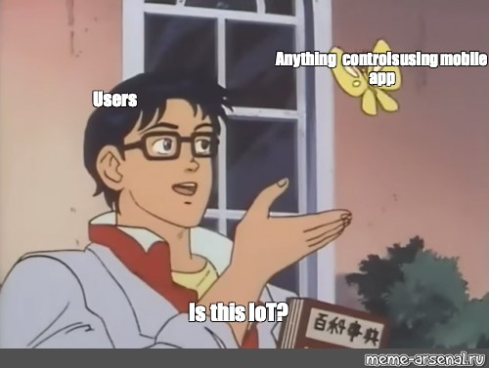
What is IoT?
The Internet of Things - network of devices that are connected to the Internet, controlled through it, and can communicate with each other.
But sometimes device can be classified as part of internet of things without an internet connection.

Slide 6

IoT security issues and risks
The total number of devices connected to the Internet is 23 billion with the prospect of increasing to 30 billion by 2020.
A significant part of the devices has security problems.
Ignoring these problems leads to the creation of botnets(Mirai, Satori) and leakage of personal data.

Slide 7

IoT security issues and risks
Due to the irresponsible approach towards IoT security, search engines for IoT have appeared:
Shodan
Censys
ZoomEye

Slide 8
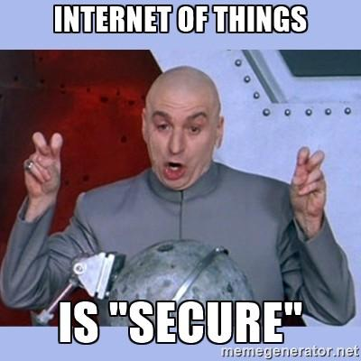
IoT security issues and risks
Violations of the principles of development:
use of hardcoded and hidden service credentials
use of the same keys and PIN codes
lack of access control when accessing a known settings page
incorrect processing of received data causing buffer overflow

Slide 9

Three main pillars
Hardware security
Software security
Radio security
(4. The fourth pillar Mobile security is also often singled out, but we will not consider it today.)

Slide 10
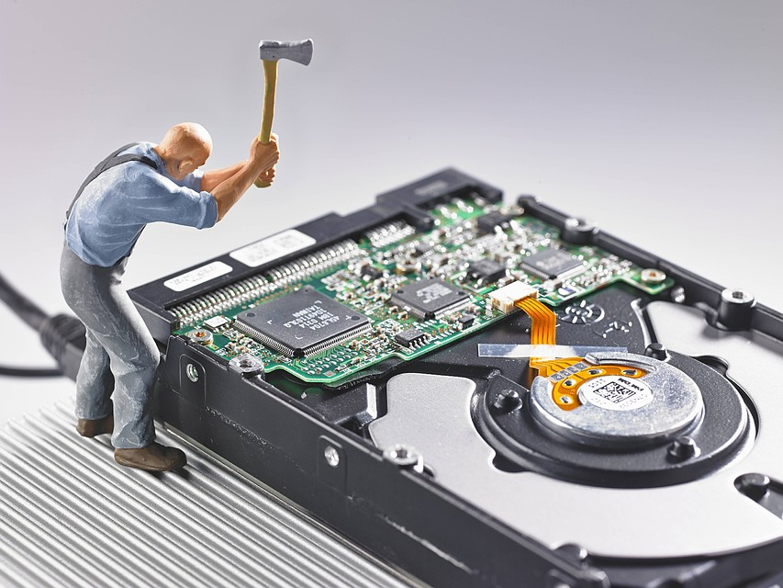
Hardware security
Hardware security is :
incorrect access to the board
work with debug ports
work with memory
work with the bootloader
(to receive a memory dump or administrative shell)

Slide 11

Little more about software
Black Box
we can sniff output from ports

Slide 12
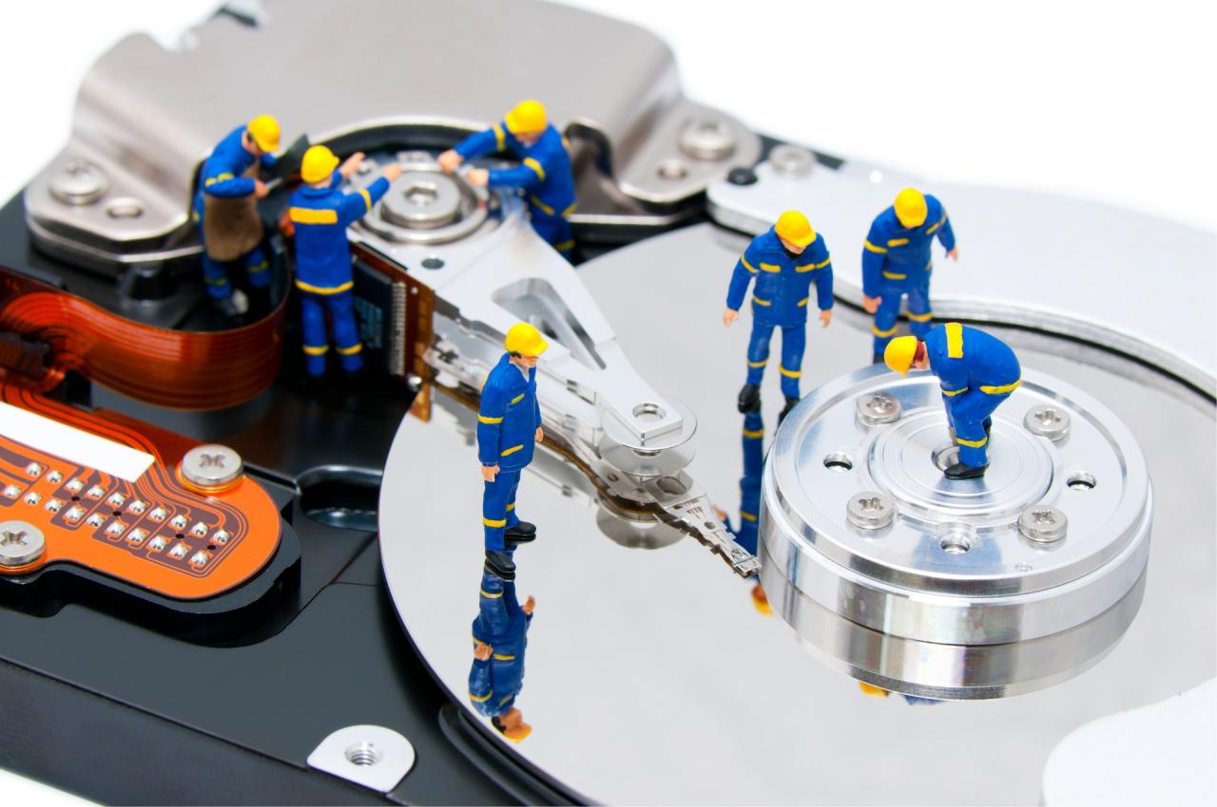
Little more about software
Black Box
we can sniff output from ports
White Box
we have a memory dump or firmware and we can analyze it

Slide 13
The biggest problem

Slide 14
The biggest problem
admin: admin

Slide 15
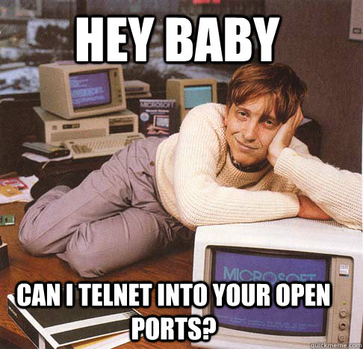
Security of communication
Сhannels through which these devices communicate with other software and devices.
At this level, security holes are most often found.

Slide 16

A little bit of everything
You need to know:
TCP/IP stack
Microcontroller Basics
Radio protocols
How to conduct reverse engineering firmware or compiled programs
Web vulnerability search
Exploiting binary vulnerabilities

Slide 17
IoT hacker Toolbox

Slide 18
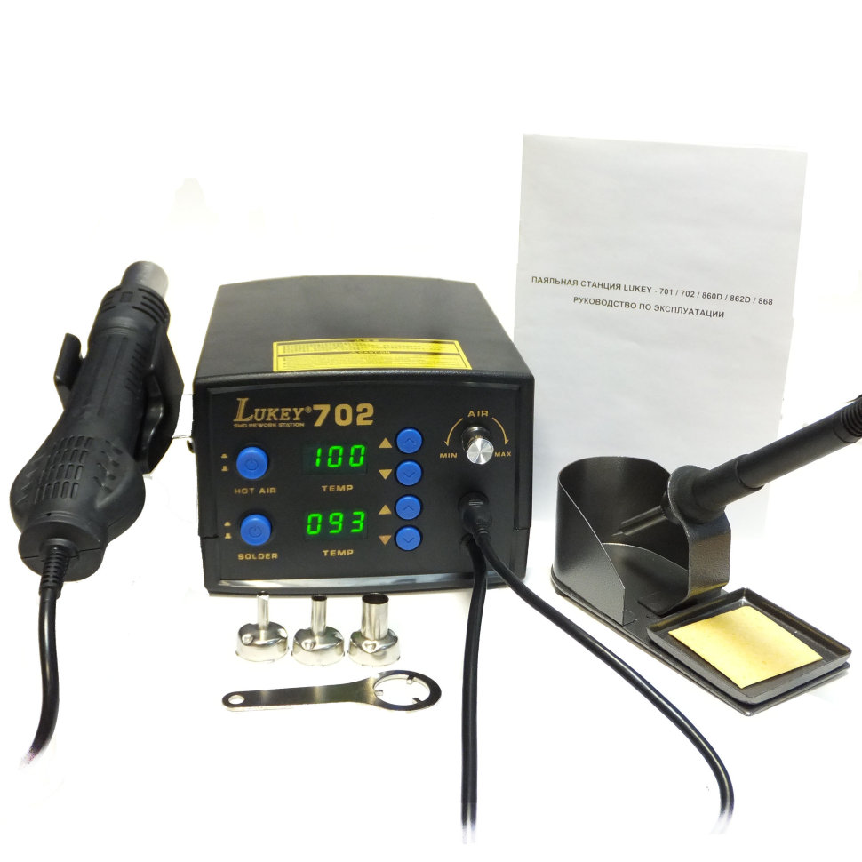
IoT hacker Toolbox

Slide 19
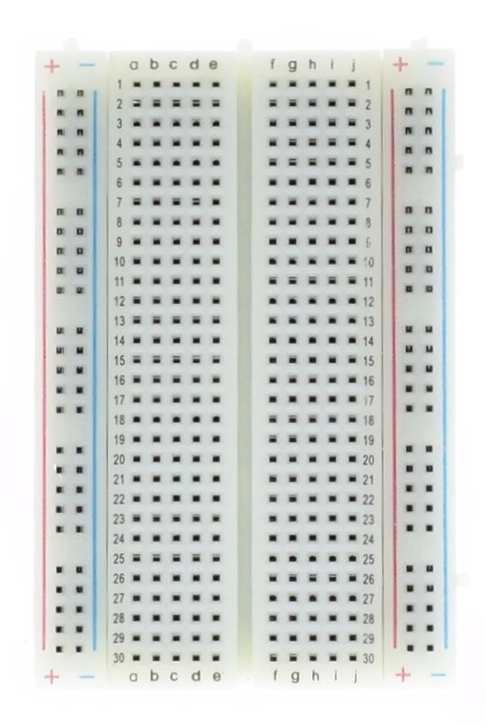
IoT hacker Toolbox

Slide 20

IoT hacker Toolbox

Slide 21
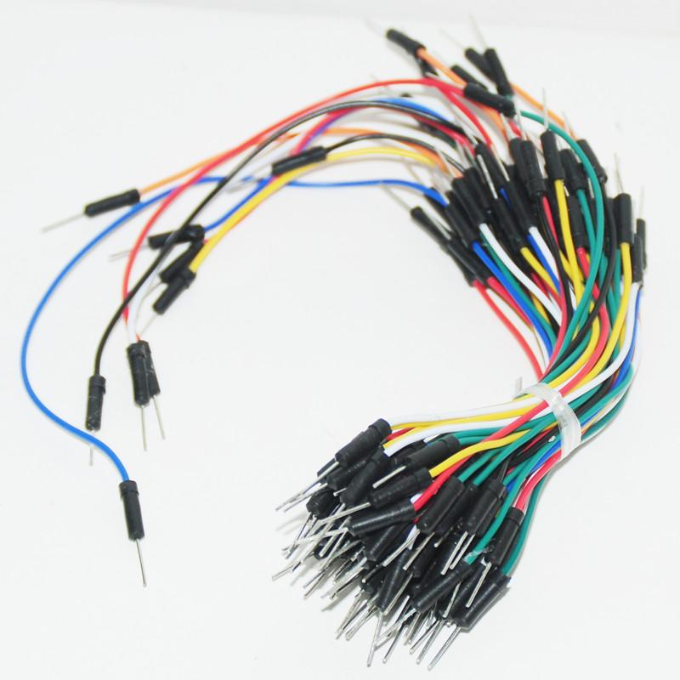
IoT hacker Toolbox

Slide 22
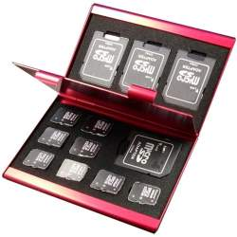
IoT hacker Toolbox

Slide 23
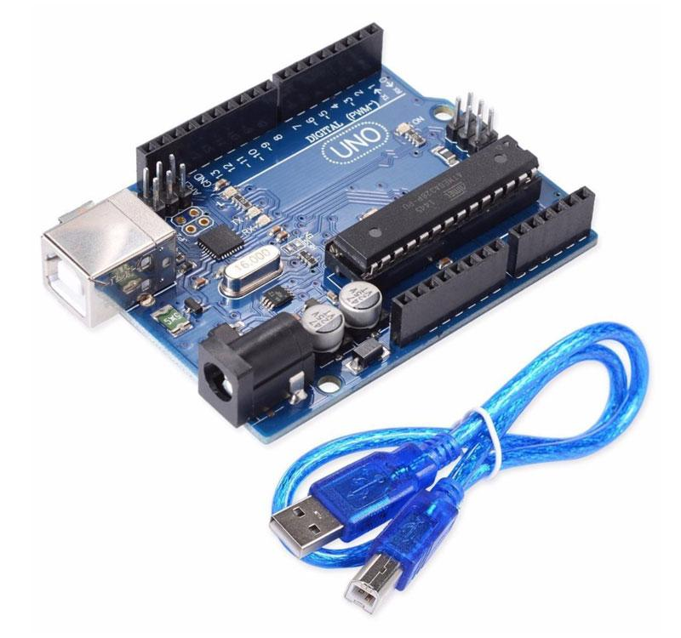
IoT hacker Toolbox

Slide 24
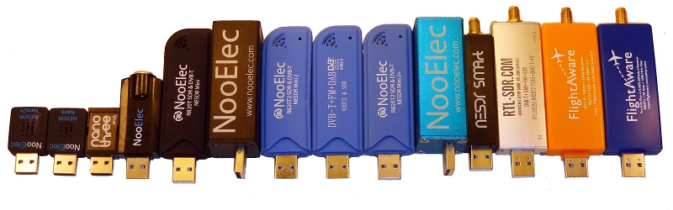
IoT hacker Toolbox

Slide 25
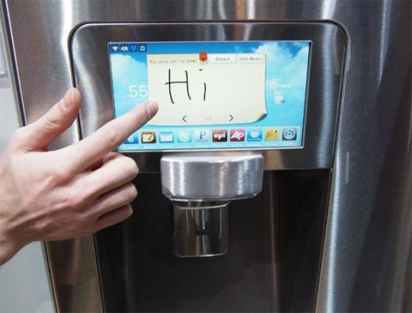
How can I hack my fridge?
Search for information about the device without interacting with it. (Federal Communications Commission ID)

Slide 26
How can I hack my fridge?
Search for information about the device without interacting with it. (Federal Communications Commission ID)
Create a general scheme that can interact with this device and through which communication channels.

Slide 27
How can I hack my fridge?
Search for information about the device without interacting with it. (Federal Communications Commission ID)
Create a general scheme that can interact with this device and through which communication channels.
For each of the devices and communication channels make a list of threats for which they need to be checked.

Slide 28

Testing problems

Slide 29

Testing problems
There are two chairs…
Write small programs each time for specific tasks and delete / forget them later
Write large programs, refine and store them somehow

Slide 30
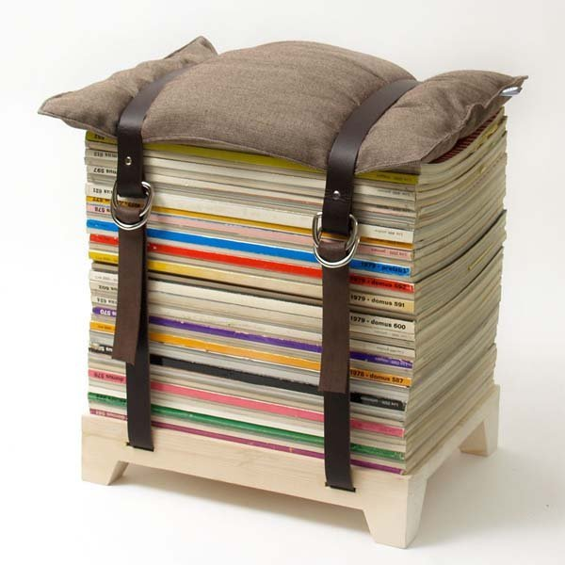
Testing problems
A little more about the first chair:
No structure
Suitable for specialized tasks
You will never use it again

Slide 31
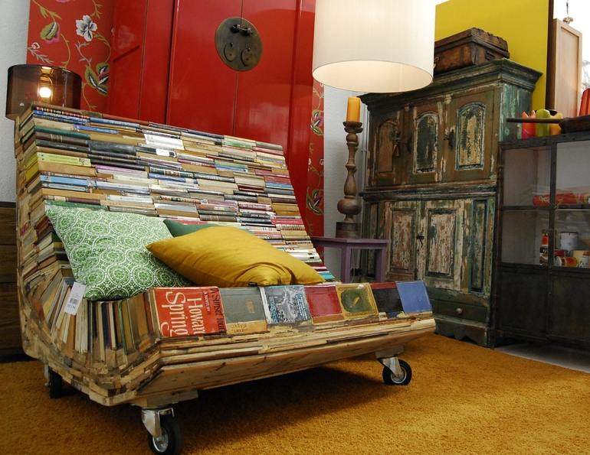
Testing problems
Second cherie:
Complicated structure
Hard to modify
Hard to support sup

Slide 32
Drakylar

Slide 33

About myself
BMSTU student 1 2 3 course
SFT0 & Invuls CTF teams player
Hacked not so smart fridge for free pizza
Rostelecom RedTeam Analyst
Tested over 30 smart devices (at last year)
Not funny kidding(but i don’t care - suffer:)

Slide 34
What do you know about other IoT frameworks?

Slide 35

What do you know about other IoT frameworks?

Slide 36
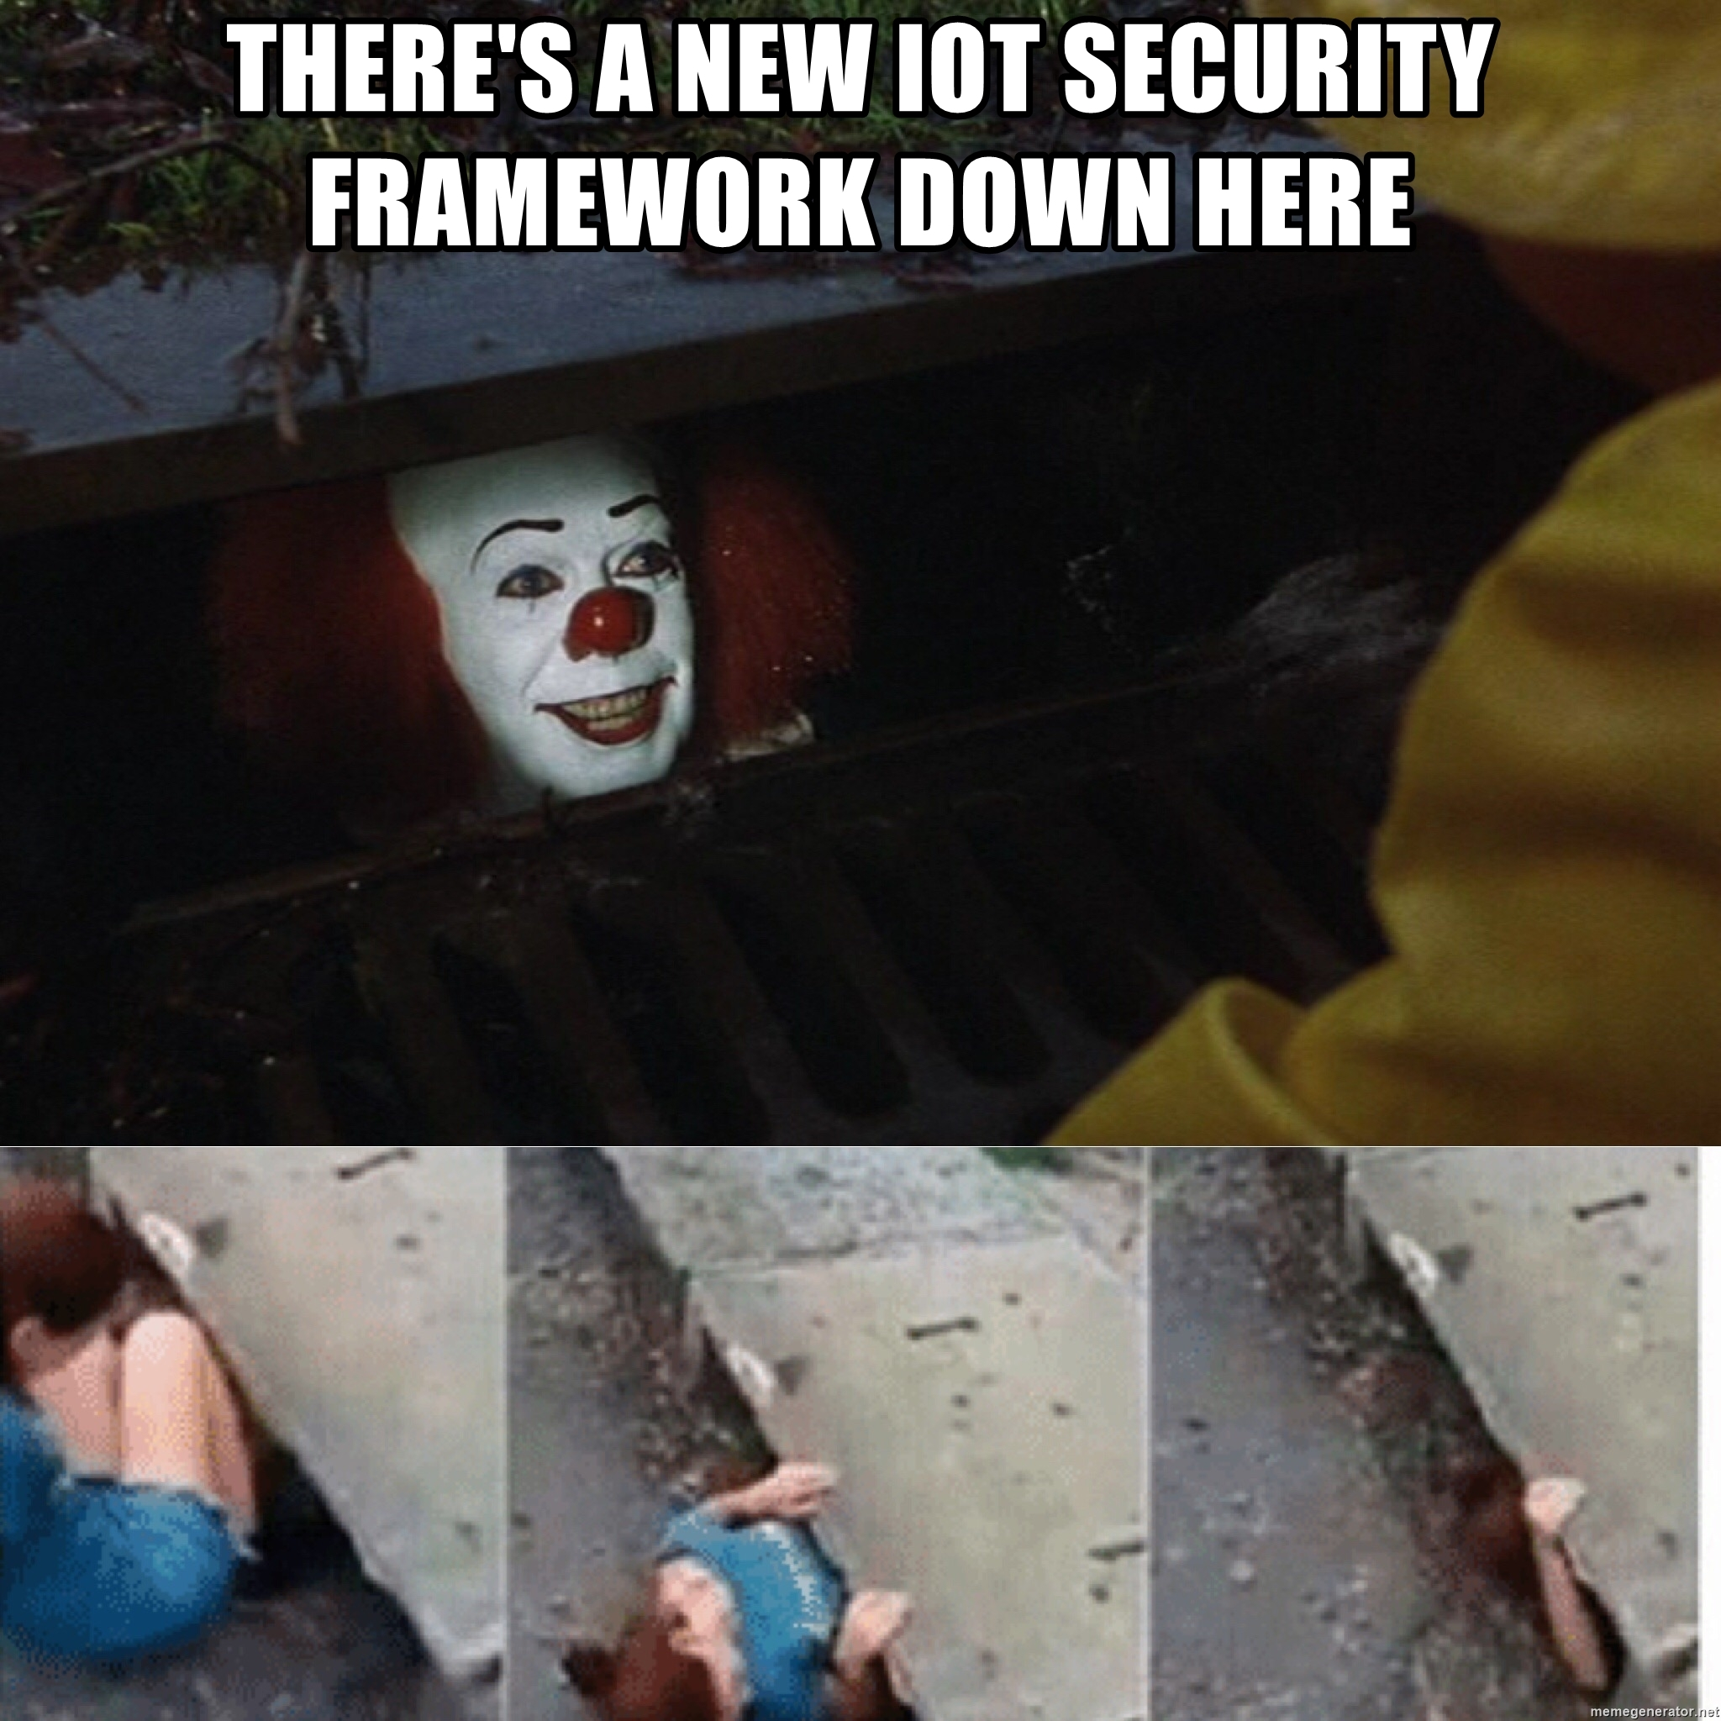
IoTSecFuzz - IoT security testing framework

Slide 37
IoTSecFuzz - IoT security testing framework
Python 3.7

Slide 38
IoTSecFuzz - IoT security testing framework
Python 3.7
> 30 submodules

Slide 39
IoTSecFuzz - IoT security testing framework
Python 3.7
> 30 submodules
Console interface

Slide 40
IoTSecFuzz - IoT security testing framework
Python 3.7
> 30 submodules
Console interface
GUI interface

Slide 41
IoTSecFuzz - IoT security testing framework
Python 3.7
> 30 submodules
Console interface
GUI interface
Profile system

Slide 42
IoTSecFuzz - IoT security testing framework
Python 3.7
> 30 submodules
Console interface
GUI interface
Profile system
Import as library

Slide 43
Hardware modules

Slide 44
UART
Baudrate bruteforce
Trying 9600:
. . . . . a . < . * . . ‘ . . ; . b
ASCII: 30%
Trying 115200:
L o a d i n g _ f i r m w a r e _ _
ASCII: 100%
. . .
Device baudrate: 115200

Slide 45

UART
Baudrate bruteforce
Trying 9600:
. . . . . a . < . * . . ‘ . . ; . b
ASCII: 30%
Trying 115200:
L o a d i n g _ f i r m w a r e _ _
ASCII: 100%
. . .
Device baudrate: 115200
baudrate.py

Slide 46
UART -> Uboot loader
Creating shell root terminal
U-Boot> setenv extra_boot_args init=/bin/sh U-Boot> setenv optargs init=/bin/sh U-Boot> setenv bootargs ${bootargs} single init=/bin/sh U-Boot> boot

Slide 47
UART -> Uboot loader
Memory dumping
U-Boot> md.l 0x40000
00040000: 33323130 37363534 62613938 66656463 0123456789abcdef
00040010:
. . .
U-Boot>

Slide 48
UART -> Uboot loader
Filesystem dumping
U-Boot> cramfsls /etc/ . . .
-rw-r--r-- 1 root root 2659 Sep 17 01:46 /etc/passwd
. . .
U-Boot> cramfsload /etc/passwd

Slide 49
UART -> Uboot loader
Filesystem dumping
U-Boot> cramfsls /etc/ . . .
-rw-r--r-- 1 root root 2659 Sep 17 01:46 /etc/passwd
. . .
U-Boot> cramfsload /etc/passwd

Slide 50
TTY Shell
Password bruteforce
. . .
> Enter login: root
> Enter password: toor
> Wrong password! . . .

Slide 51
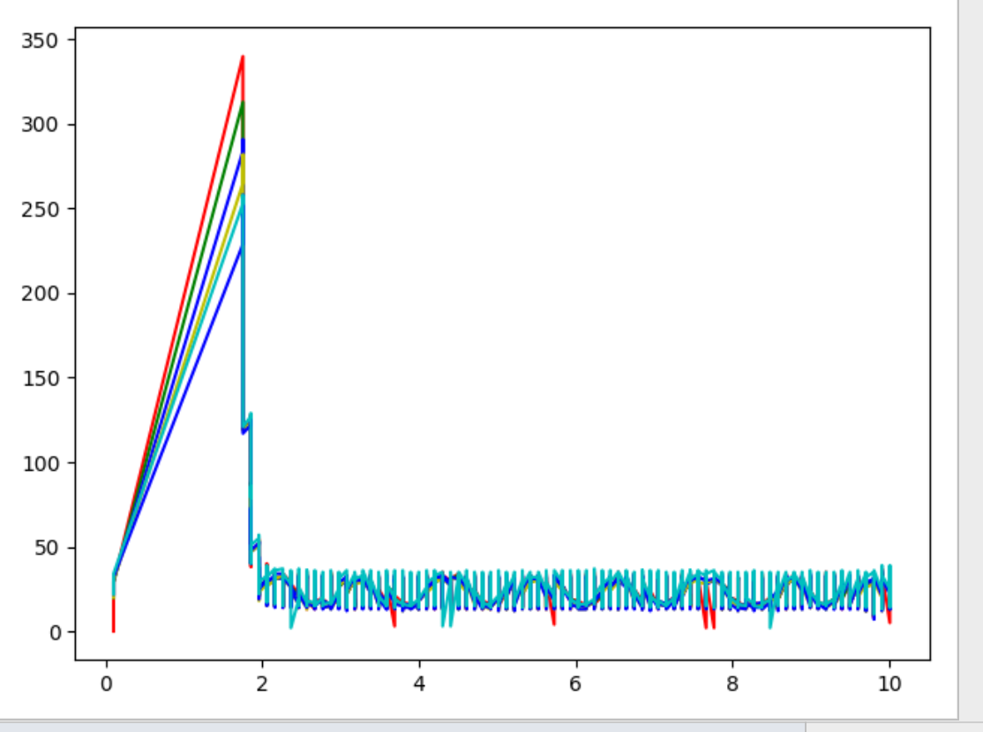
Cheap logic analyzer
Arduino UNO

Slide 52
Software modules

Slide 53
Binwalk API module
> binwalk firmware.bin
< [
[6264, 'LZO compressed data'],
. . .
]

Slide 55


Slide 56


Slide 57


Slide 58

Firmware hardcoded credentials

Slide 59
Firmware hardcoded credentials
Found file: /etc/passwd
Found hardcoded password: $1$V.dD1/c1$VHercFBRjVLXgKQTQqzGG.
Found file: /etc/proftpd/ftpd.passwd Found hardcoded password:
$1$nbFjxIr4$5xMoTwMGJ9.ja5ovXgRFN1
. . .

Slide 60
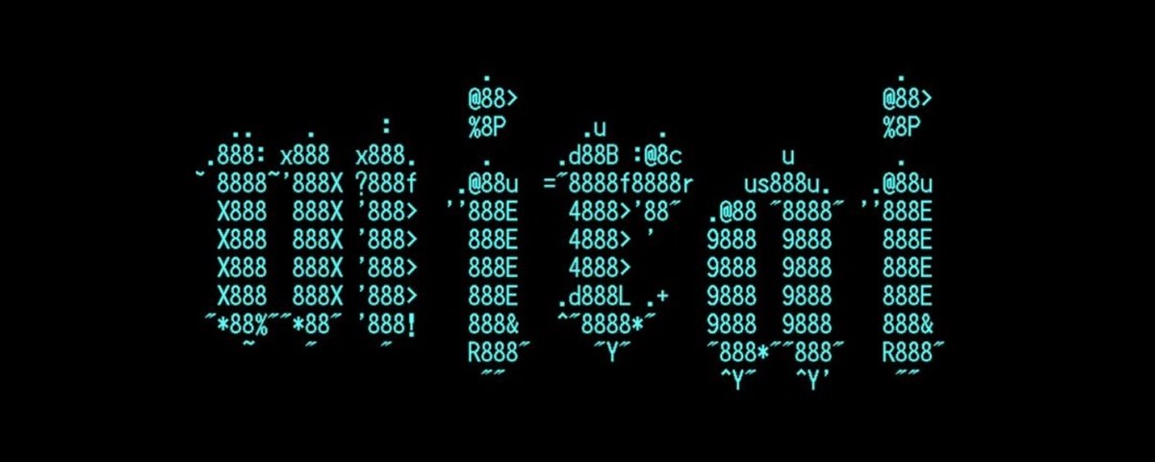
Password fast dictionary bruteforce module

Slide 61

Password fast dictionary bruteforce module

Slide 62
Password fast dictionary bruteforce module
Import password: $1$V.dD1/c1$VHercFBRjVLXgKQTQqzGG.
Trying admin..
Trying root..
. . .
Trying toor..
Success!

Slide 63
Communication modules

Slide 64
WIFI -> Deauth
SSID MAC of WIFI network: 00:11:22:33:44:55
Client MAC: AA:BB:CC:DD:EE:FF
Deauthing client…
OK! Create your fake WIFI access point!

Slide 65

WIFI -> WPA2 Handshake Cracker
SSID MAC of WIFI network: 00:11:22:33:44:55
AP Name: kill-me-please
Dictionary: /tmp/10k.txt
Capturing handshake... Captured!
Trying 10000 passwords
. . .
Found: P73wefim458fjwe30234jfma

Slide 66
WIFI -> Probe sniffing
Starting probe sniffing!
Device AA:BB:CC:DD:EE:FF tried to connect to “HP”
Device 00:11:33:33:77:00 tried to connect to “Samsang”
. . .
Return:
“AA:BB:CC:DD:EE:FF”: “HP”
“00:11:33:33:77:00”: “Samsang”

Slide 67
ARP -> Finding
Starting ARP-Finding!
Found: AA:BB:CC:DD:EE:FF Found: 00:11:22:33:44:55
. . .
List of found addresses:
[“AA:BB:CC:DD:EE:FF”, “00:11:22:33:44:55”, . . . ]

Slide 68

ARP -> Spoofing
Gateway ip: 192.168.1.1
Target: 192.168.1.123
Packets amount: 1000
Starting...
Got MAC address of 192.168.1.1
Got MAC address of 192.168.1.123
Capturing packets...
Finished!

Slide 69
NRF24 -> Find addresses
Sniffing for NRF24 Stream.
Changing channel to: 1
Changing channel to: 2
. . .
Most common addresses:
[“00:00:00:00:00”, “AA:BB:CC:DD:EE”, . . . ]

Slide 70
NRF24 -> Send bytes
Device address: AA:BB:CC:DD:EE
Channel: 11
Bytes: 0x1337
Sending bytes... Done!

Slide 71
One more probem..

Slide 72
+100500 same options depend on manufacturers/devices
Options transmission between security specialists

Slide 73

+100500 same options depend on manufacturers/devices
Options transmission between security specialists

Slide 74



Profile system

Slide 75
Profile system
Save & Restore options

Slide 76
Profile system
Save & Restore options
Share options with friends

Slide 77
Profile system
Save & Restore options
Share options with friends
Share options with everyone

Slide 78
BronzeBee

Slide 79

bronzebee@zn2018:~$ whoami
MIEM HSE student (3rd grade)
Sberbank cyber security department intern
Lunary & Invuls CTF team member
Node.js developer

Slide 80
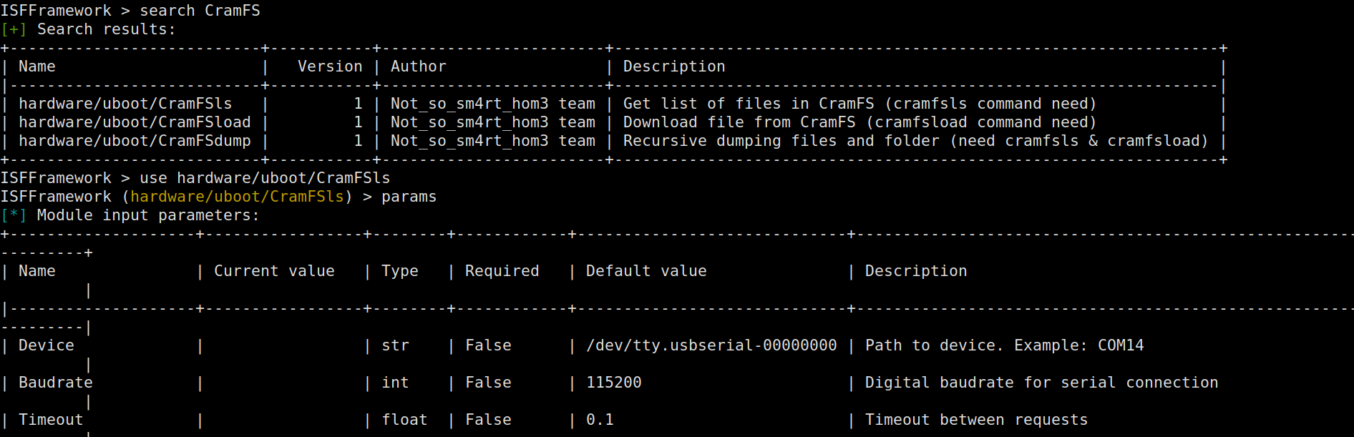
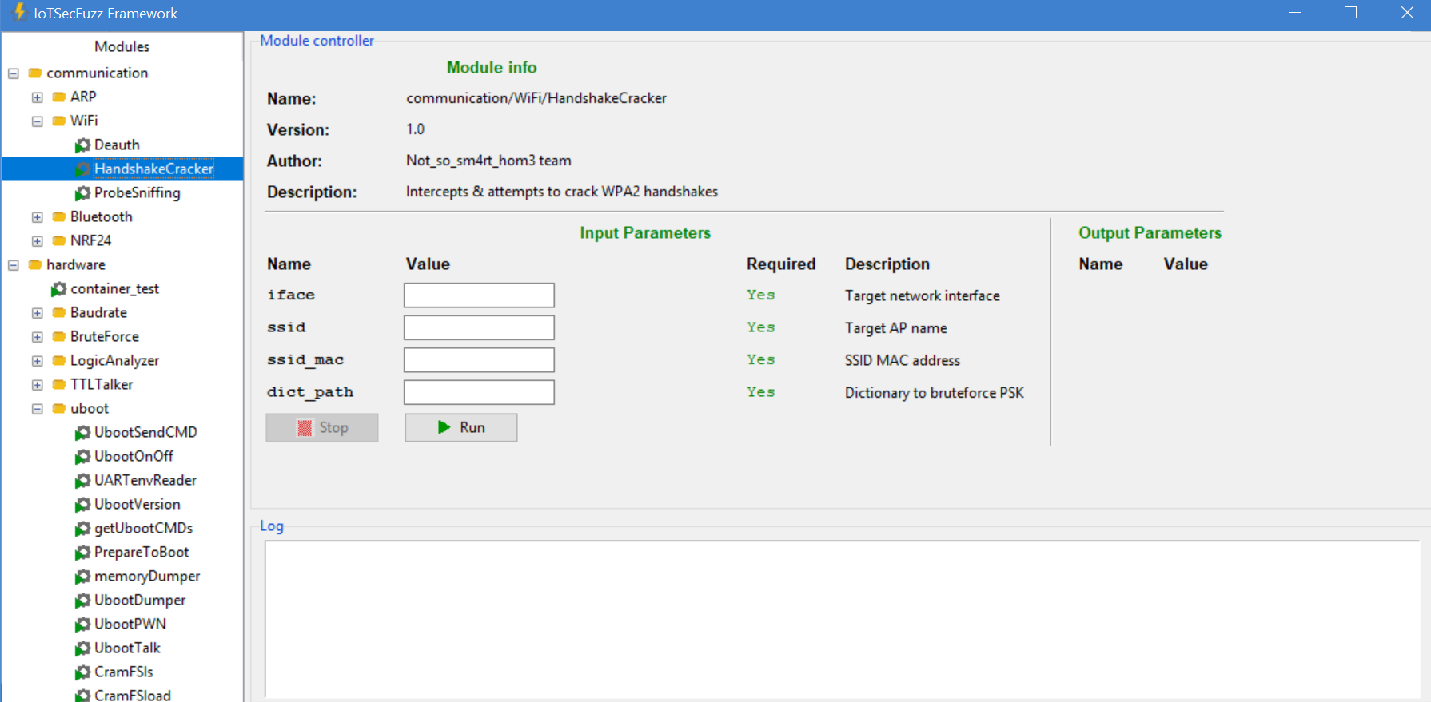
Console & GUI mode

Slide 81
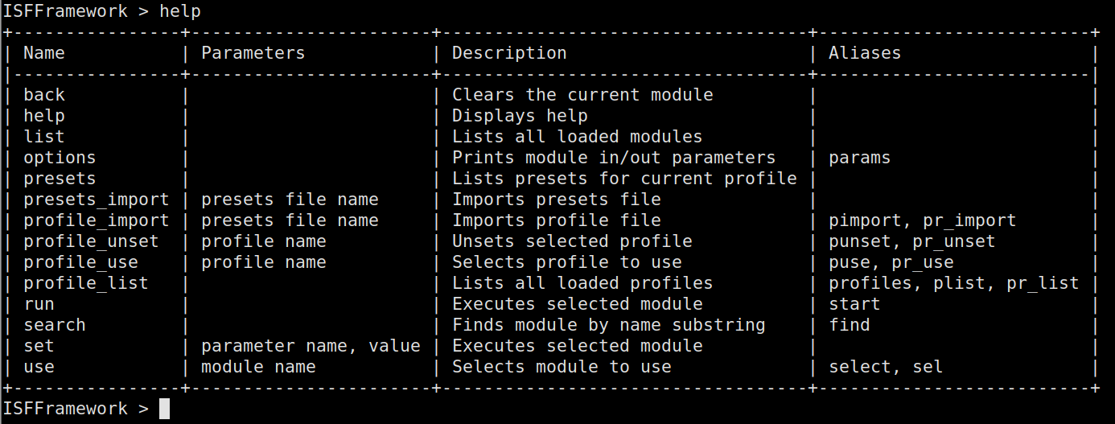
Console mode
20+ commands

Slide 82
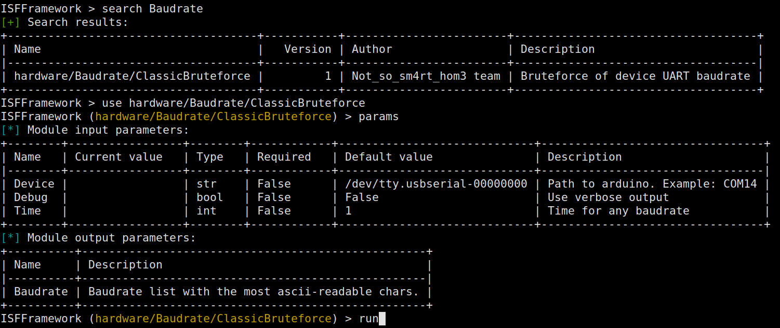
Console mode
module usage

Slide 83
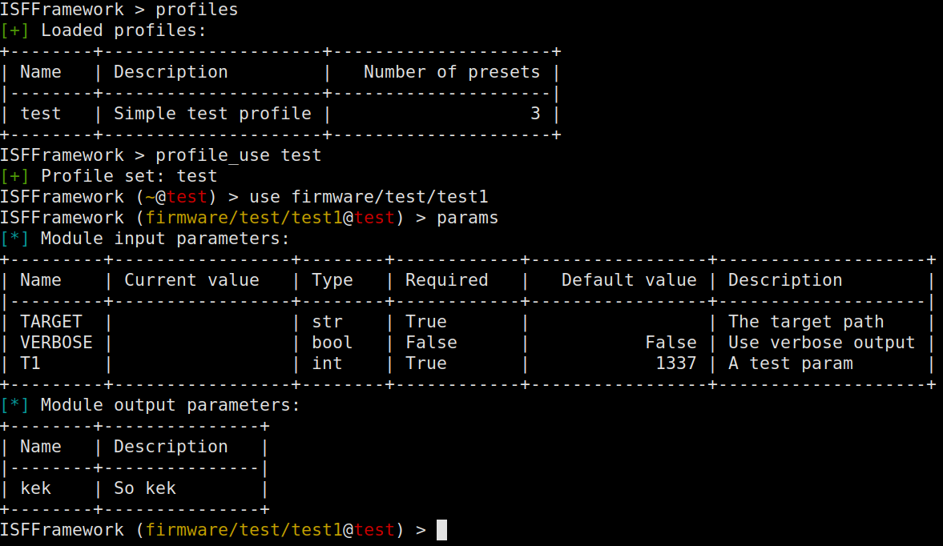
Console mode
profiles

Slide 84
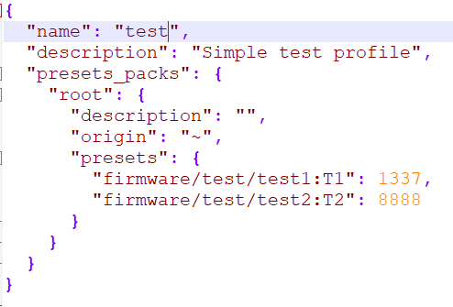
Profiles
on the inside

Slide 85
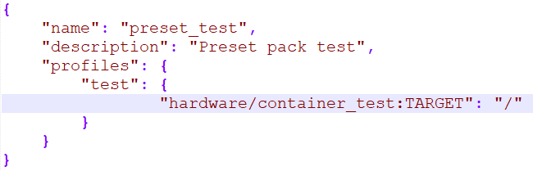
Profiles
presets for existing ones
imported via presets_import command

Slide 86
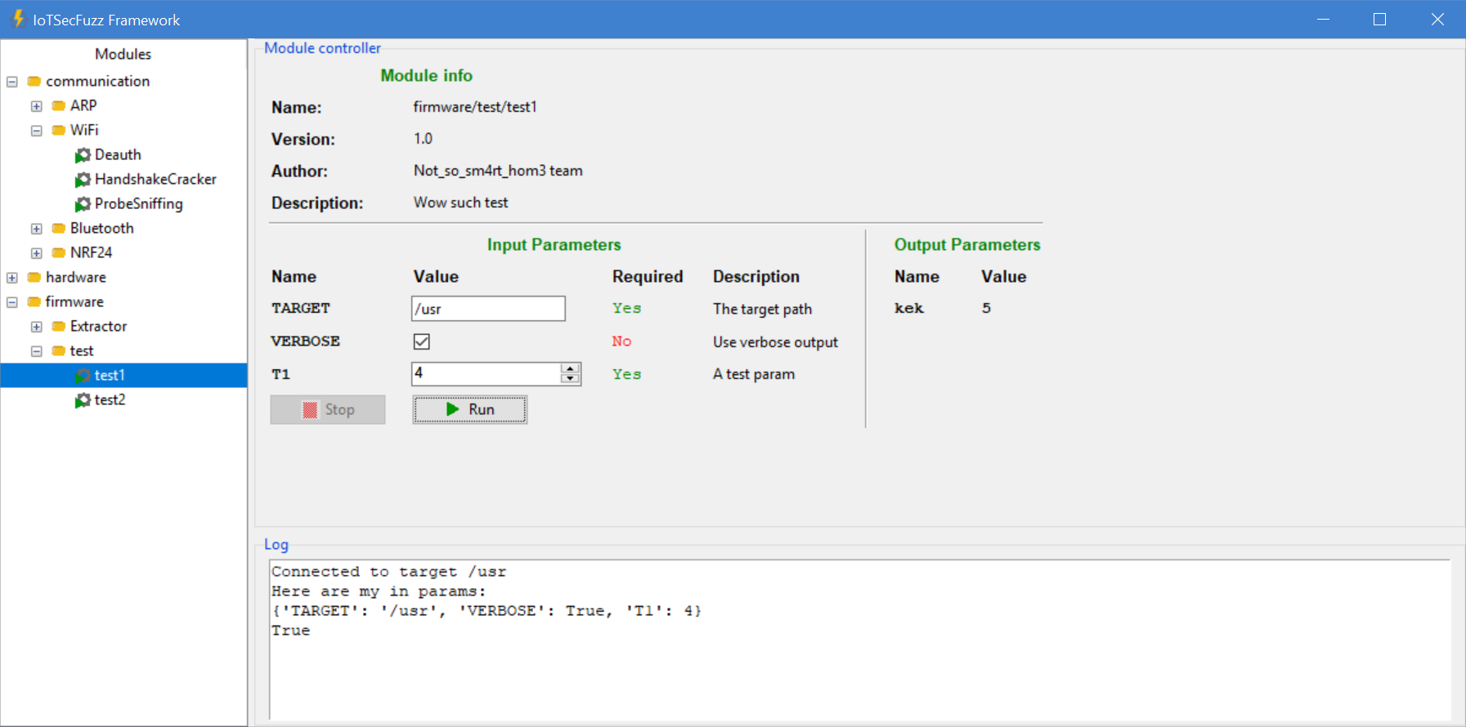
GUI mode

Slide 87
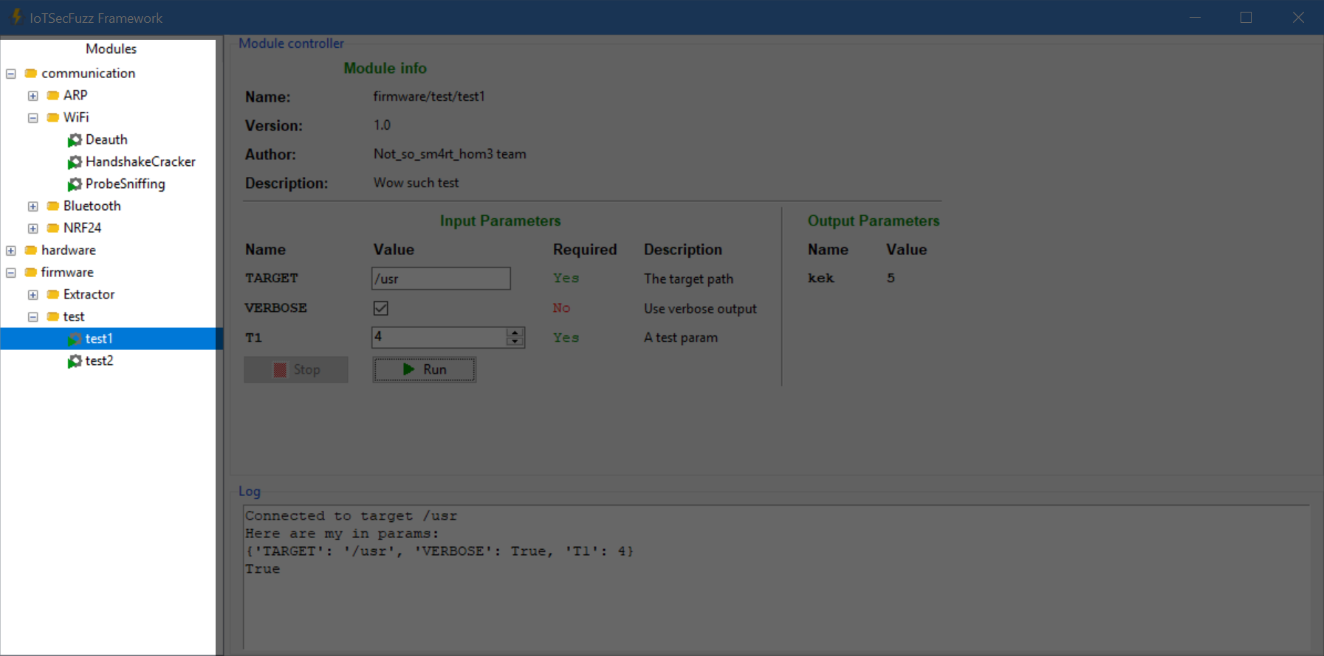
GUI - module tree

Slide 88
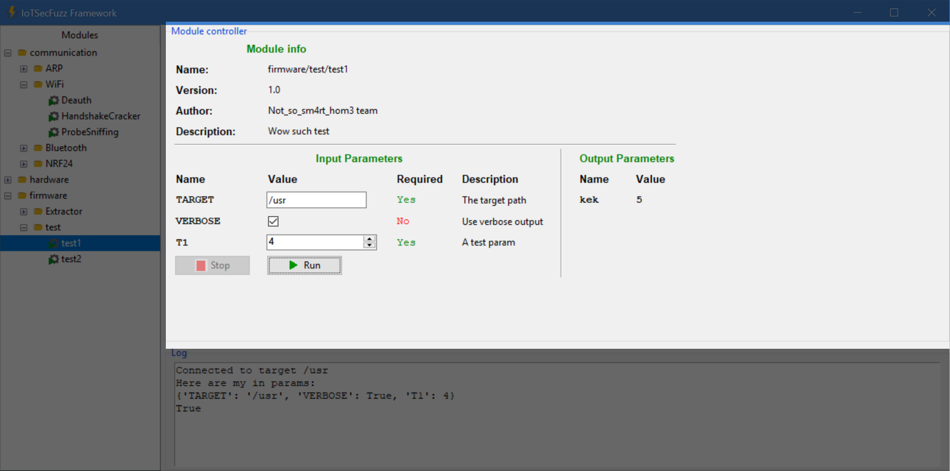
GUI - module controller

Slide 89
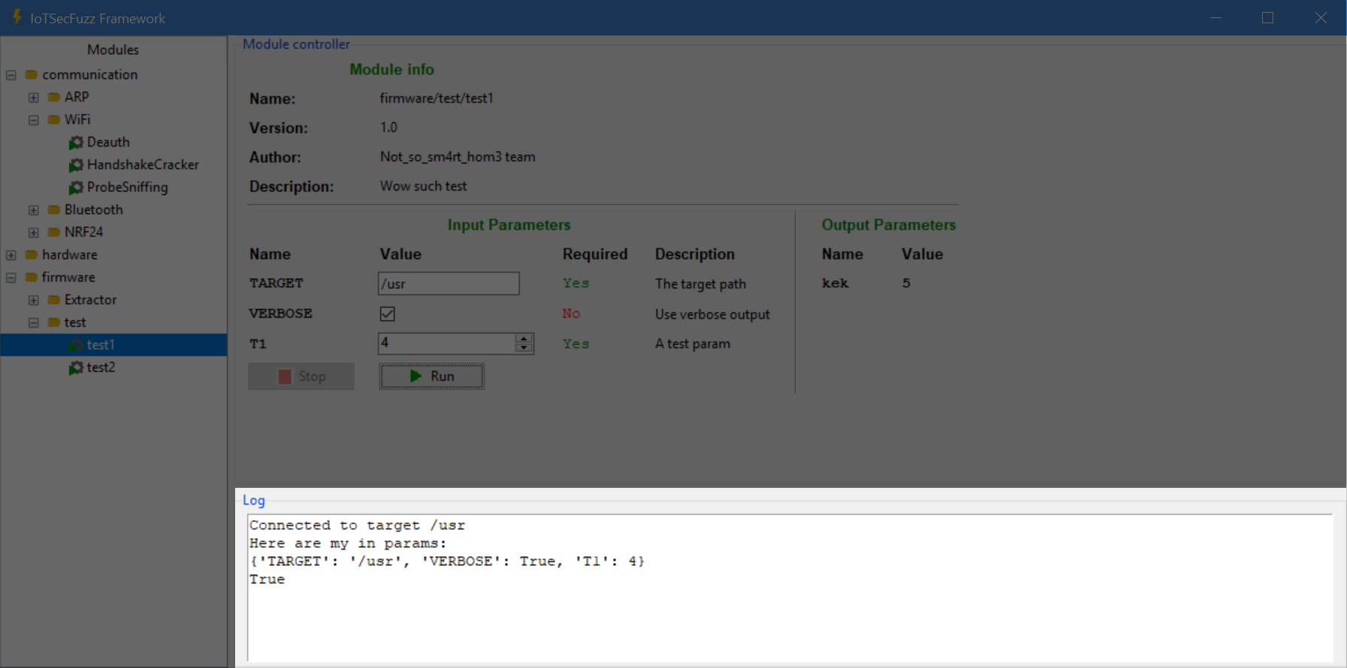
GUI - log window

Slide 90
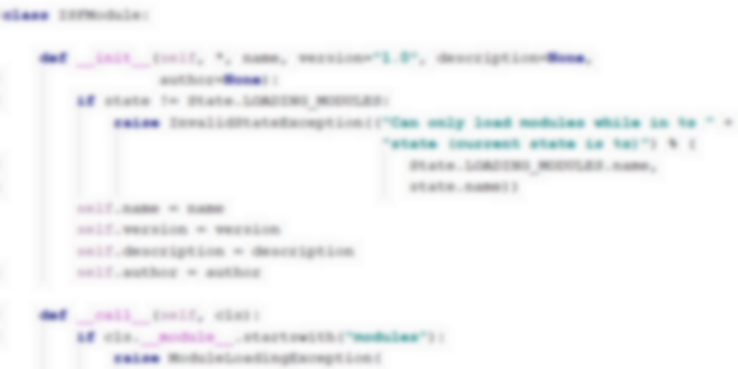
What’s under the hood
?

Slide 91

Module
atomic work unit of framework
Module lifecycle:
Initialized
Executed with pre-validated input parameters
Returns output parameters (if any)
Destroyed

Slide 92
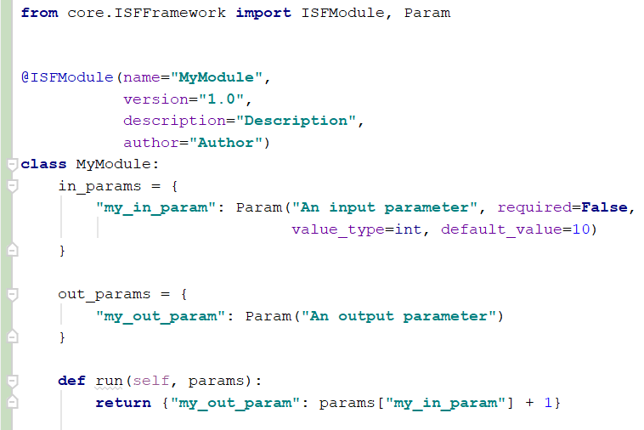
Software interface of module
Defined in separate class
Ability to set parameter description, type, default value, etc.
name/version/description/author provided in the @ISFModule decorator

Slide 93
Software interface of module
Input parameters description provided through in_params field
Execution with specified parameters through run method (also returns output parameters)
Access other modules using get_module_class method

Slide 94

Atomic module problem
Overview
Good for targeted exploits, but not for general-purpose tasks
Terrible for hardware multi-step modules: requires either creating a library or initialize new session each time sub-task is executed
Still makes you to split each sub-task into different file with module wrapper & same input parameters to connect to device

Slide 95
Atomic module problem
CramFS example
CramFSdump command using this approach:
Initialize CramFSls module (open connection)

Slide 96
Atomic module problem
CramFS example
CramFSdump command using this approach:
Initialize CramFSls module (open connection) -> run CramFSls

Slide 97
Atomic module problem
CramFS example
CramFSdump command using this approach:
Initialize CramFSls module (open connection) -> run CramFSls -> destroy CramFSls (close connection)

Slide 98
Atomic module problem
CramFS example
CramFSdump command using this approach:
Initialize CramFSls module (open connection) -> run CramFSls -> destroy CramFSls (close connection) -> Initialize CramFSload (open connection)

Slide 99
Atomic module problem
CramFS example
CramFSdump command using this approach:
Initialize CramFSls module (open connection) -> run CramFSls -> destroy CramFSls (close connection) -> Initialize CramFSload (open connection) -> run CramFSload

Slide 100
Atomic module problem
CramFS example
CramFSdump command using this approach:
Initialize CramFSls module (open connection) -> run CramFSls -> destroy CramFSls (close connection) -> Initialize CramFSload (open connection) -> run CramFSload -> destroy CramFSload (close connection)

Slide 101
Atomic module problem
CramFS example
CramFSdump command using this approach:
Initialize CramFSls module (open connection) -> run CramFSls -> destroy CramFSls (close connection) -> Initialize CramFSload (open connection) -> run CramFSload -> destroy CramFSload (close connection) -> Initialize CramFSdump (open connection)

Slide 102
Atomic module problem
CramFS example
CramFSdump command using this approach:
Initialize CramFSls module (open connection) -> run CramFSls -> destroy CramFSls (close connection) -> Initialize CramFSload (open connection) -> run CramFSload -> destroy CramFSload (close connection) -> Initialize CramFSdump (open connection) -> run CramFSdump

Slide 103
Atomic module problem
CramFS example
CramFSdump command using this approach:
Initialize CramFSls module (open connection) -> run CramFSls -> destroy CramFSls (close connection) -> Initialize CramFSload (open connection) -> run CramFSload -> destroy CramFSload (close connection) -> Initialize CramFSdump (open connection) -> run CramFSdump -> destroy CramFSdump (close connection)

Slide 104

Atomic module problem
CramFS example
CramFSdump command using this approach:
Initialize CramFSls module (open connection) -> run CramFSls -> destroy CramFSls (close connection) -> Initialize CramFSload (open connection) -> run CramFSload -> destroy CramFSload (close connection) -> Initialize CramFSdump (open connection) -> run CramFSdump -> destroy CramFSdump (close connection)

Slide 105

Atomic module problem
Solution
Single class to contain multiple modules and common input parameters which is capable of context management (annotated with @ISFContainer decorator)
Run method of each submodule is defined as method in container class and takes additional input parameters from @submodule decorator

Slide 106
Atomic module problem
Solution
Allows the developer to call submodules within the same function as if they were simple functions
Ability to access container using get_container_class method
From user’s perspective, containers/submodules are regular modules (all the work with context is done behind the scene)

Slide 107
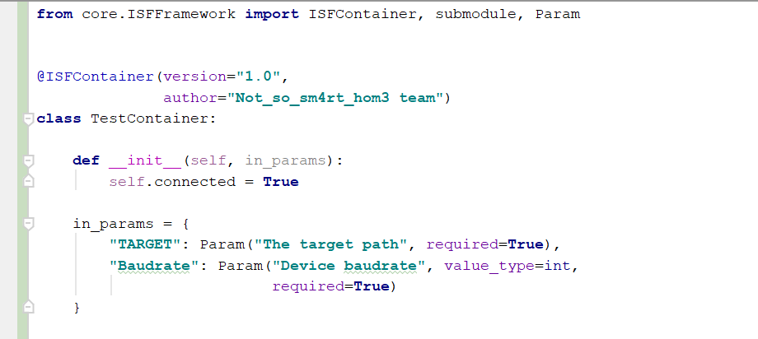
Atomic module problem
Solution

Slide 108
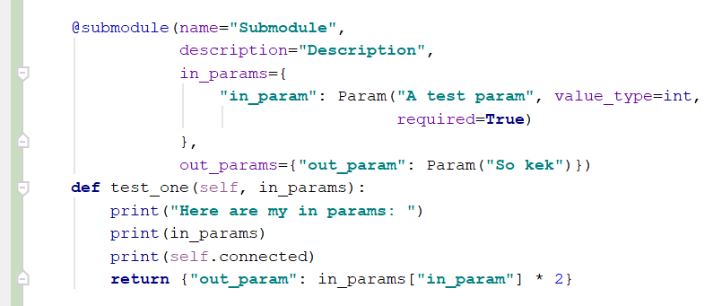
Atomic module problem
Solution

Slide 109
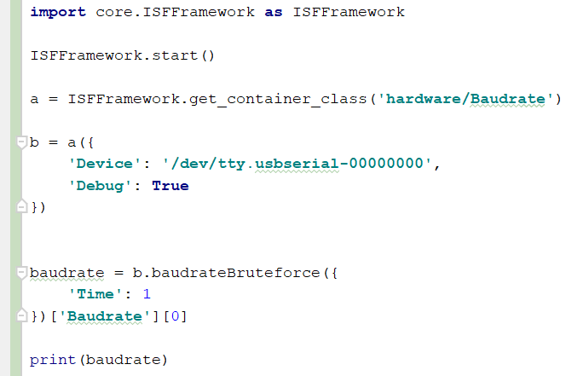
Use framework as library
Yep, it’s that simple!

Slide 110
What’s next?
More modules, profiles & supported devices
Community development: website, forum
Centralized module & profile organization:
ability to submit modules for framework repositories & install them directly from application interface

Slide 111
Questions?

Slide 112
Thanks for attention!
Gitlab: https://gitlab.com/drakylar1/iotsecfuzz Marakhovich Sofia: @Soff_M
Shaposhnikov Ilya: @drakylar
Bliznyuk Sergey: @bronzebee

